Slide 1

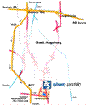
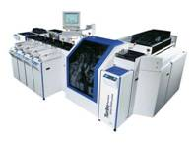
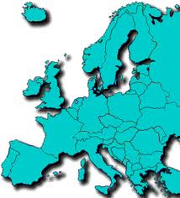


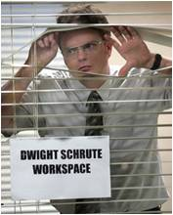



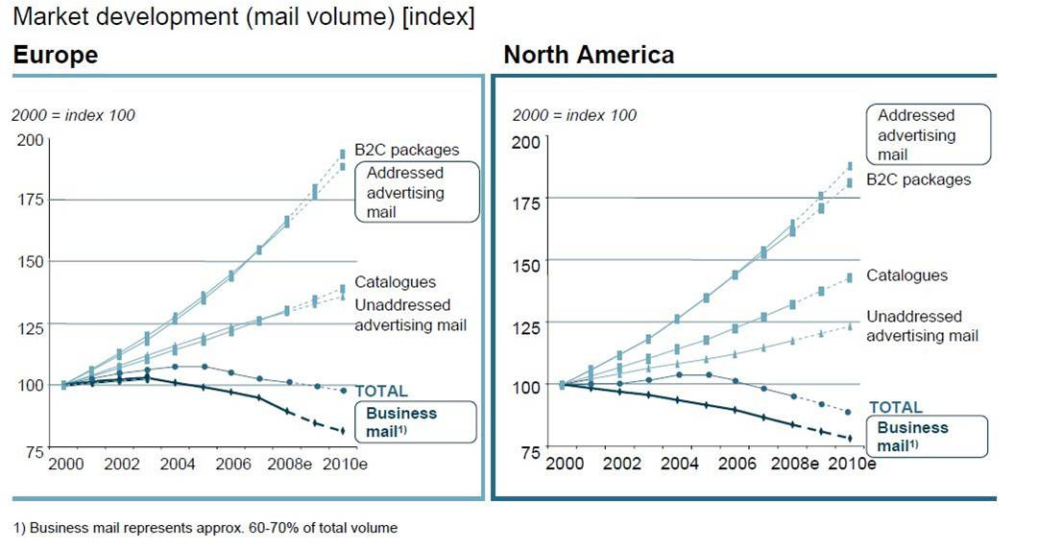
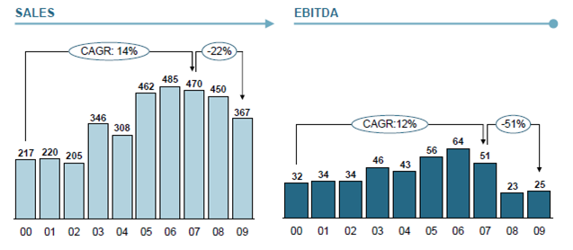




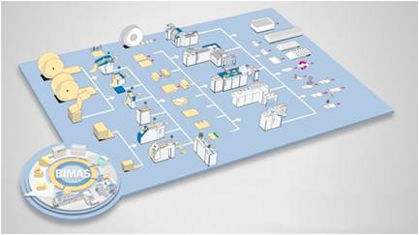
Germany
BÖWE SYSTEC AG: A Strategic Response to Challenges to Its Core Business
By: Bryan Abbott, Rachel Colangelo, Sabrina Haran, Adam Sanner & Lea Zglobicki – University of Pittsburgh
Stefanie Hausler, Laura Mühldorfer and Andrea Wittek – University of Augsburg
Interesting Question
Böwe Systec AG – Company Overview
S.W.O.T. Analysis: Böwe Systec AG –
Strengths and Weaknesses (Internal)
Implementation Challenges
Short-Term: Establishing a Plan for Financial Solvency
- Opportunities: A reasonable plan could end the bankruptcy threat, while securing a viable source-of-credit for future work
- Risks: Bankruptcy proceedings could lead to the company being bought or taken over by a competitor or creditor
Mid-Range: Pursuing Opportunities Related to the Liberalization of Postal Service in the European Union
- Opportunities: The change in laws in 2011 and 2013 could generate a significant source of new business opportunities in the company’s core inserting and sorting product lines
- Risks: The market for private postal service in Europe is unclear, so entrepreneurs and companies may be hesitant to make substantial investments in equipment
Long-Term: Making the Transition from Inserting and Sorting Machines to Software and Services for Electronic Mailrooms
- Opportunities: Inserting and sorting machines are expensive products that are paper-intensive. Software and service is both innovative and more attentive to “green” pressures
- Risks: Inserting and sorting machines are the company’s core business. This would be a significant shift in focus.
How can Böwe Systec AG capitalize on its
established global presence and strong
technological infrastructure in response to
the economic and social challenges to the
company’s mail-sorting technology business?
Strengths (Internal):
40% market share in Western Europe for insertion systems and 70% market share in Western Europe for sorting systems
Broad product portfolio in inserting, sorting, processing and software
Established infrastructure for providing service on equipment throughout Europe
Weaknesses (Internal):
High price point for inserting and sorting machine products
Poor cash position has led to high reliance on credit and bankruptcy
Currently in the midst of a complex and expensive restructuring effort
Böwe Systec AG is one of a small group of companies (Foxray,
Datafinity) who concentrate this technology and associated
services in comprehensive electronic mailrooms services for
clients
Böwe Systec AG is the parent company of the Böwe Group
(Böwe Systec, Böwe Bell & Howell, Böwe Cardtec, Lasermax Roll
Systems).
The company is working through a massive restructuring effort to
improve efficiency. On April 30th, the company reported a net
loss of EUR 25.4 million and reported that sales had declined
from EUR 424.2 million in FY 2008 to EUR 367.1 million in
FY 2009
The Traditional View of the Mailroom
P.E.S.T. Analysis: Political and Economic Issues in the Mailroom Industry
Political Factors:
In Europe, postal markets will be liberalized in 2011 and 2013, which is likely to create a private postal industry
The European Union has passed laws to promote recycling and to restrict the creation of new landfill sites
Economic Factors:
The mailroom industry is facing a steep decline in business mail volume in response to the economic downturn. The economic situation in Europe is currently bleak.
The mailroom industry is also being negatively-impacted by cost-cutting measures, as companies can save money by not investing in mailroom infrastructure
S.W.O.T. Analysis: Böwe Systec AG –
Opportunities and Threats (External)
Takeaway
Opportunities (External):
Liberalization of European postal markets should create opportunities for mailing and inserting machines for private postal services
Growing interest in managing secure mailrooms via software and technology
Threats (External):
Strong political and social pressure to reduce the use of paper in offices and in mailing
Transaction mail volume continues to decline in the economic downturn
Companies continue to face pressures to reduce mailing costs in the economic downturn
Böwe Systec AG is in the midst of a tough restructuring effort, but occupies an interesting niche as one of the leaders in providing high speed mail sorters. The company should be proactive with greater focus on software, consulting and “green” alternatives to paper mail.
Mailrooms are mindless and repetitive support units in
organizations, for workers with minimal skills and little career
ambition
Mailrooms are dependent on inefficient stakeholders such as the
postal service (snail mail) and outdated paper-related industries
Electronic Mailrooms:
Industry Overview
P.E.S.T. Analysis: Social and Technical
Issues in the Mailroom Industry
Works Cited
Böwe Group. (2010). Company Presentation – “Industry Analysis at
Böwe Systec AG.” Augsburg, Germany: May 12.
Böwe Group. (2010). Company Press Release – “BCC Software Launches Intelligent Mail Website.” Augsburg, Germany: January 6.
Böwe Group. (2010). Company Press Release – “Sale of Böwe
Systec AG in Decisive Phase.” Augsburg, Germany:
August 4.
Rosenthal, Elisabeth. (2010). “In Europe, the Trash Burns Green.”
New York Times. Tuesday April 13.
Sanders, Laurel. (2009). “The Digital Mailroom: A Closer Look at
Document Classification and Data Capture to Increase
Overall Process Efficiency.” CXO Magazine. June.
Social Factors:
Individuals and companies place a greater emphasis on issues such as privacy and security in mail and communication
As part of Europe‘s green movement, there is growing social pressure for individuals and companies to utilize “paperless“ billing and record-keeping
Technological Factors:
The mailroom industry has numerous participants that are developing optical systems and software for mail sorting
Industry leaders and innovators are also focusing on developing technology to monitor the security of the mailing process from sender to recipient
Recommendations
There are several companies (Pitney Bowes, Hewlett-Packard,
IBM) who have developed technology and software to allow
companies to sort through 30,000 pieces of physical mail per
hour, and digitize this mail so that it can be combined with
email and internet inquiries
There are several companies (IBM, Microsoft, Google) who
have developed software to allow professionals in a variety of
industries to work on documents simultaneously
There are several companies (Pitney Bowes, Hewlett-Packard,
IBM) who have developed systems that are designed to control
how documents are shared to balance the need to put sensitive
documents into the hands of the professionals who need them
vs. complying with strict regulations for who can see/access
them
Short-Term: Over the next 6 months, Böwe Systec AG needs to focus on stabilizing its financial situation to secure additional credit and committing to a plan to keep the company from returning to bankruptcy
Mid-Range: Over the next 3 years, Böwe Systec AG should develop relationships with the entrepreneurs and organizations that are likely to need significant infrastructure for private postal services in Europe following the new laws in 2011 and 2013
Long-Term: By the late 2010s, the company should make a substantial shift away from the sale of paper-intensive inserting and sorting machines toward providing software and services for electronic mailrooms.

