Slide 1
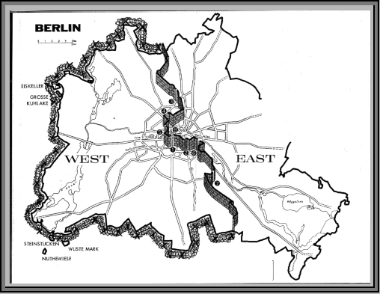
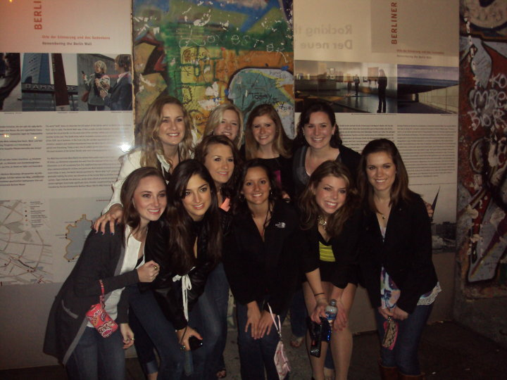
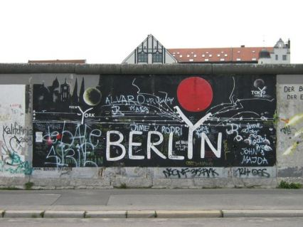
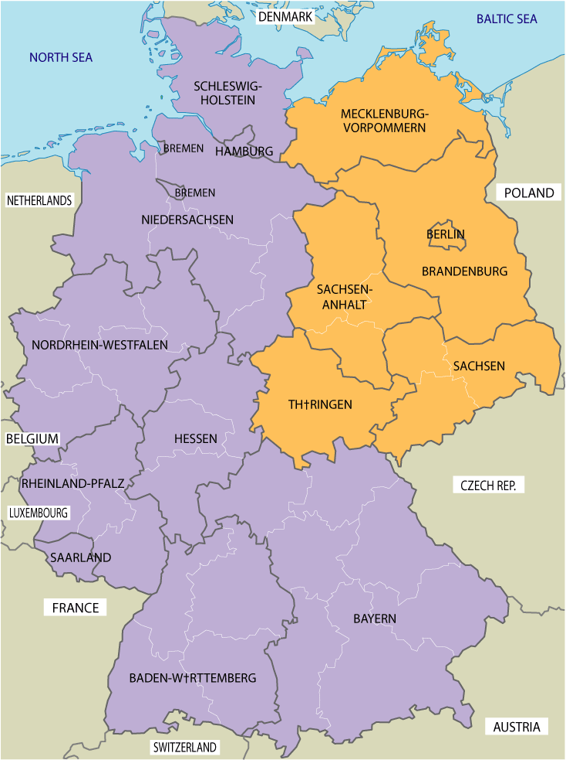
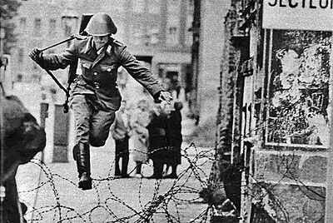
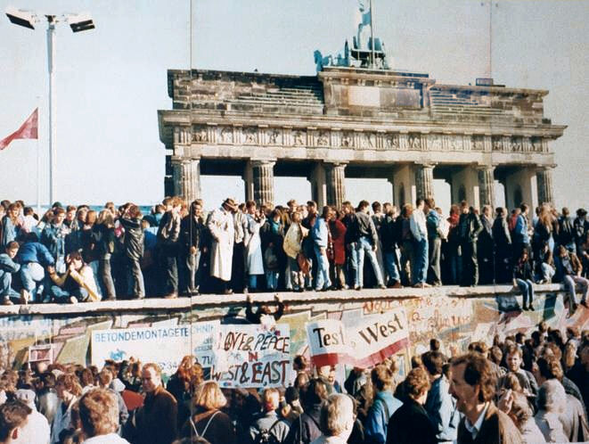
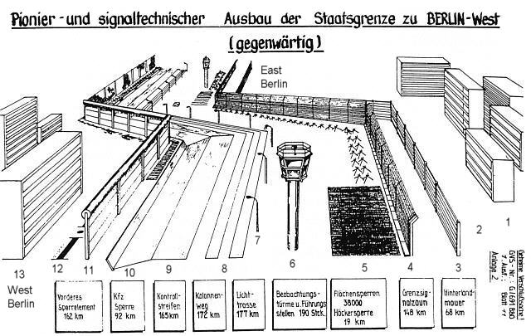
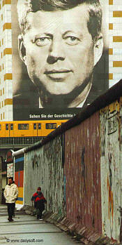
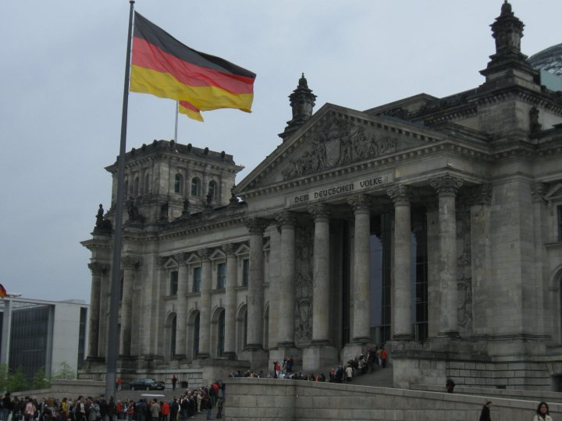
Germany
The “Shadows” of the Berlin Wall
Ray Jones – CBA
Interesting Question
The Rise of the Berlin Wall –
August 13, 1961
The Wall in East Germany and East Berlin, 1961-1989
The “Shadow” of the Wall:
Berlin in 2010
Why is the Berlin Wall a significant
cultural symbol in Germany and
throughout the world?
In the East, the Berlin Wall became the physical and psychological barrier separating whole families for nearly 30 years
The wall was known as the ‘Anti-Fascist Protection Wall” by the communist East German Democratic Republic
As former GDR leader Eric Honsecker commented in 1989, “The Wall will be standing in 50 and even in 100 years, if the reasons for it are not yet removed.”
The Berlin Wall remains a symbol of how government can oppress individual freedom and liberty
The fall of the Berlin Wall and its remnants/relics remain symbols of how individuals can overcome an oppressive or unjust system
The reunification of West Berlin and East Berlin, of West Germany and East Germany, and of the Soviet Union and Eastern Bloc with the West has been a long and complex process
The East German government established the wall, virtually overnight, to close the “last gap” in between East and West Germany.
East German citizens were not allowed to leave East Germany without official permission (which was rarely granted).
Berlin from 1945-1961: East and West Germany
Plus 3 Students at the Berlin Wall - 2010
At the end of WWII in 1945, Germany was divided in to West Germany (Federal Republic of Germany in 1949) and East Germany (German Democratic Republic in 1949)
Even though Berlin is in the East, it was divided into 4 sectors (American, British and French in the West; Soviet in the East)
Between 1949-1961, more than 2.6 million of the 17 million citizens of East Germany escaped to West Berlin
Conrad Schuman:
A Symbol of the Desire for Freedom
From 1961-1989, more than 5,000 citizens attempted to escape over the Berlin Wall into West Berlin.
171 people were killed or died attempting to escape
November 9, 1989:
The Fall of the Berlin Wall
Takeaway
In 1984, Mikhail Gorbachev became the 7th and last head-of-state of the Soviet Union, and ushered in the era of Perestroika (“restructuring”) and Glasnost (“openness”) which would lead to the fall of the Soviet Union and the Eastern Bloc by 1991
In 1987, President Ronad Reagan gave a famous speech in Berlin in which he said “Mr. Gorbachev, tear down this wall!”
The Berlin Wall has been a significant international cultural symbol since its establishment in 1961. For decades, it represented oppression and secrecy. After its fall in 1989, it became a symbol of hope for reconciliation among Germans and citizens worldwide.
Engineered to Deter Defection:
The Wall as an Instrument of Fear
One of the most famous successful escapees was Conrad Schuman, an East German soldier who was photographed jumping over a barbed-wire Berlin Wall in 1961. He lived in Bavaria until 1998
On November 9, 1989, the East German government
announced that travel restrictions to West Berlin had been lifted. That night, hundreds of thousands of people celebrated throughout the city.
The Wall in West Germany and West Berlin, 1961-1989
Works Cited
1 – East Berlin
2 – Border Area
3 – Backland Wall
4 – Signal Fence
5 – Various Ground Barriers
6 – Watch Towers
7 – Lighting System
8 – Column Track
9 – Control Track
10 – Anti-Vehicle Trenches
11- Last Wall – “The Wall”
12 – Border
13 – West Berlin
Buckley, William F., Jr. (2004). The Fall of the Berlin Wall. Hoboken,
NJ: John Wiley and Sons.
Childs, David H. (2001). The Fall of the GDR: Germany’s Road to
Unity. London: Longman, Pearson and Co.
Gaddis, John L. (2005). The Cold War: A New History. New York:
Penguin Press.
Hertle, Hans-Hermann. (2008). The Berlin Wall: Monument of the
Cold War. New York: Springer-Verlag.
German Federal Foreign Office. (2010). Facts About Germany.
Berlin: Directorate-General for Culture and Communication.
Taylor, Frederick. (2006). The Berlin Wall: A World Divided 1961- 1989. London: Harper Perennial.
October 3, 1990:
German Reunification
In the West, the Berlin Wall became the symbol of the Cold War between the West and the Soviet Union.
For West Germans and West Berliners, it was known as the “Wall of Shame” – a symbol of everything that was wrong with a Communist state (The Stasi, secrets, lies, neighbors spying )
In October of 1990, the German Democratic Republic (previously East Germany) acceded to the Federal Republic of Germany (previously West Germany)
The German President, Richard von Weizsacker, commented that “The day has come on which for the first time in history the whole of Germany takes a permanent place among Western democracies.”
Plus 3 Student Photograph of the German Bundestag (Parliament) in Berlin – May 2010

